Slide 1
IBM University Engagement Project Submission
“Exploring the Power of Agentic AI with IBM Granite and LangFlow”

Slide 2

Project Tile – [RozgarMitra AI – AI Job Mentor for Informal Workers]
Domain of Project – [Education ]
Student Name | Recent Passport Photo | Email ID | Mobile number [WhatsApp]
Amogh Dixit |  | AICTE Enrollment : amoghdixit063@gmail.com IBM skillbuild and IBM Cloud Email ID: amogh2518@gmail.com | 9044893800

Slide 3
Problem Statement -
The Challenge
Navigating today's competitive employment landscape presents significant barriers for early-career professionals, recent graduates, and vocational job seekers. Professional career counseling and mock interviews remain prohibitively expensive and inaccessible. Modern Applicant Tracking Systems (ATS) reject resumes through rigid keyword-based filters without offering actionable feedback or remediation. Candidates lack structured frameworks for behavioral interview preparation (e.g., STAR methodology) and role-specific technical drills. Furthermore, generic AI chatbots frequently hallucinate, lose conversational context, and drift into irrelevant non-career topics due to the absence of domain-specific guardrails.
The Objective
Build an AI-powered Career Mentorship Agent (RozgarMitra AI) that delivers personalized career guidance, resume feedback, interview preparation, and job-fit analysis using IBM Granite on IBM watsonx.ai, orchestrated via LangFlow. The system provides:
▪ Personalized Career Profiles Capture and manage candidate skills, experience, and goals in a persistent context store.
▪ Contextual Resume Audit Calibrated 1–10 scoring with 3 strengths, 3 improvements, and a rewritten professional summary.
▪ STAR Interview Simulation Dynamic behavioral and technical interview question generation with expert evaluation tips.
▪ Multi-Agent System Autonomous coordination of specialized agents (Profile, Resume, Interview).

Slide 4
The proposed solution is a multi-agent AI-powered Career Mentorship System built using LangFlow, IBM watsonx.ai, and IBM Granite Models (ibm/granite-3-8b-instruct) to provide personalized, real-time career coaching, resume feedback, interview preparation, and job-fit analysis through coordinated autonomous agents.
The system consists of five key agents:
▪ Candidate Profile Agent captures and manages candidate skills, experience, and career goals in a persistent JSON-based context store, ensuring continuity across all modules.
▪ Resume Evaluator Agent performs semantic analysis of resumes against target job descriptions, computing a calibrated quality score (1–10), identifying 3 concrete strengths and 3 actionable improvements, and rewriting the professional summary.
▪ Interview Coach Agent generates 5 tailored interview questions mixing behavioral (STAR-methodology) and technical questions, each paired with expert evaluation tips for strong answers.
▪ Conversational Career Mentor Agent provides 24/7 interactive career guidance with strict domain guardrails that politely decline off-topic queries (e.g., cooking, politics, entertainment) to maintain professional focus.
The solution features a clean Streamlit multi-page frontend and leverages IBM Cloud watsonx.ai infrastructure for secure, scalable model inference and AI governance.
Proposed Solution -

Slide 5
Technology Used
LangFlow Platform – For designing and orchestrating multi-agent prompt chains, domain guardrails, and conditional workflow execution visually.
IBM Granite Model (ibm/granite-3-8b-instruct) – IBM's open-source, instruction-following foundation model for natural language understanding, reasoning, and structured career guidance.
IBM Cloud – Provides the enterprise-grade infrastructure to build, deploy, and scale the RozgarMitra AI agent system. IBM Cloud enables secure IAM-based credential management and scalable API endpoints.
IBM watsonx.ai – For foundation model lifecycle management, parameterised inference control (Temperature: 0.7, Repetition Penalty: 1.1, Max Tokens: 1024), and enterprise AI governance.
IBM Bob – AI-powered coding assistant to generate and refine application code, debug errors, understand implementation logic, and accelerate the development of the Project.
Streamlit (Python 3.11+) – Responsive multi-page web application frontend delivering Profile Management, Resume Review, Career Guidance, Interview Preparation, and Job Matching interfaces.
JSON-Based Data Persistence – Zero-database, lightweight file-based storage for candidate profiles, sample job listings, and multi-turn conversation history.

Slide 6
LangFlow Components Used -
1) Chat Input – Interface where job seekers enter their career queries, paste resumes, specify target job roles, or upload job descriptions for analysis.
2) IBM watsonx AI Agent – Processes user input using the IBM Granite model, applying specialised prompt templates for resume evaluation, interview question synthesis, and career guidance.
3) Granite-3-8B-Instruct Model – The core foundation model configured with optimised parameters (1024 max tokens, 0.7 temperature, 1.1 repetition penalty) for high-precision, instruction-following career advice.
4) Chat Output – Renders structured feedback including calibrated resume scores (1–10), bulleted strengths and improvements, STAR interview rubrics, and job-fit match percentages.
5) File & Data Store Component – Serialises candidate profile metadata (skills, experience, career goals) and persists multi-turn conversation history in lightweight JSON format.
6) Domain Guardrail Filter – Intercepts and classifies user prompts, politely declining non-career queries (e.g., cooking, politics, entertainment) and redirecting users to professional topics.
7) Context Injection Node – Automatically merges the candidate's persistent profile data into the prompt context before each Granite inference call, ensuring deeply personalised responses.

Slide 7
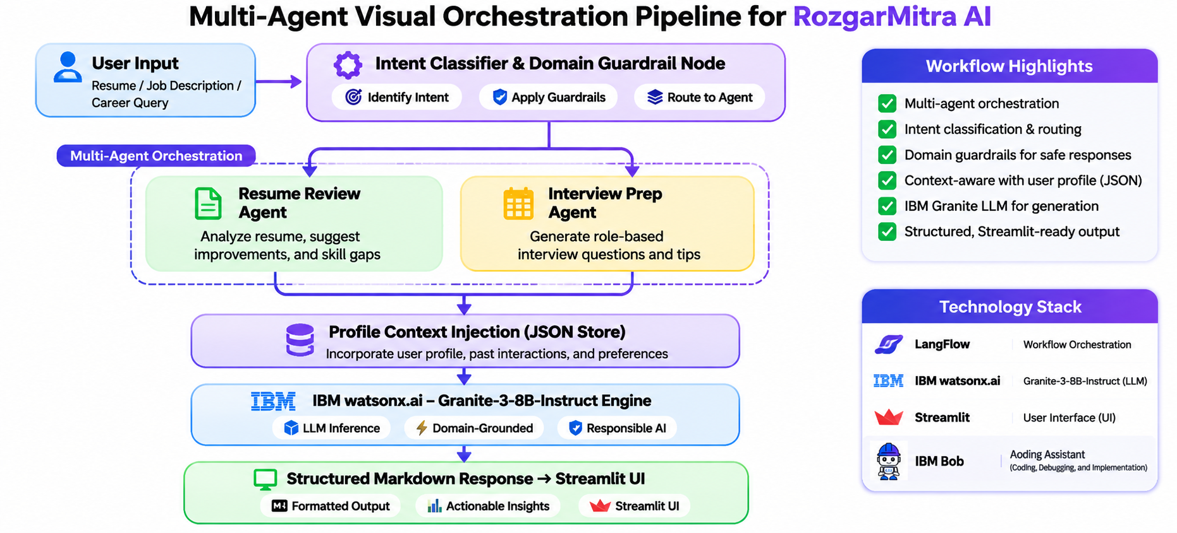
LangFlow Workflow -

Slide 8
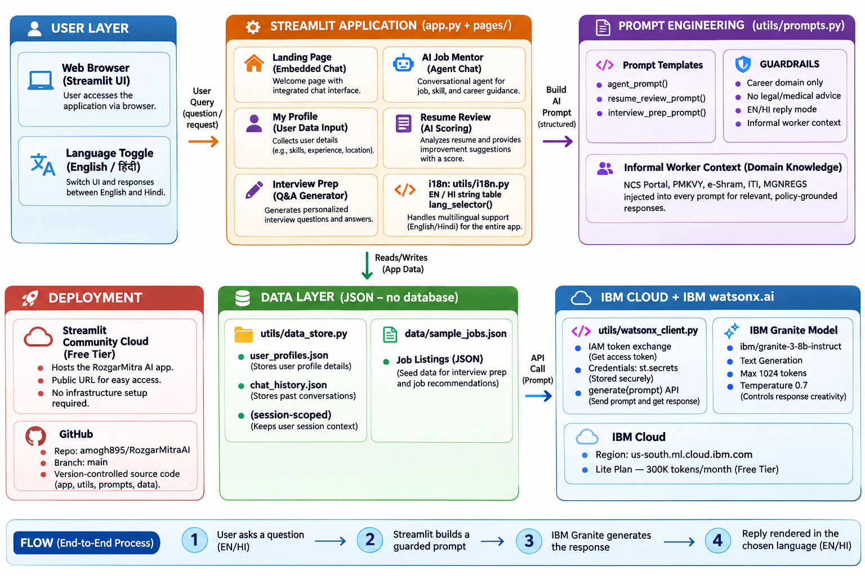
Architecture Blueprint -

Slide 9
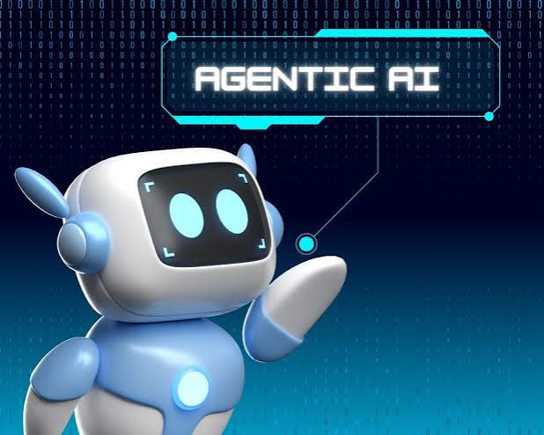
Role of Agentic AI in the Solution -
Agentic AI transforms RozgarMitra AI from a standard reactive chatbot into an autonomous, goal-directed career mentorship system:
▪ Autonomous Task Specialisation: Rather than relying on a single monolithic prompt, the system decomposes complex career guidance into focused sub-tasks handled by dedicated agent personas (Resume Auditor, Interview Coach, Job-Fit Analyst), yielding dramatically higher precision.
▪ Persistent Context Awareness: The system dynamically retains the candidate's skills, experience, and career goals across every tab and session, tailoring mock interviews and job match scores without requiring repeated manual inputs.
▪ Proactive & Actionable Guidance: Instead of providing passive, generic answers, the agents proactively identify concrete skill deficits, recommend specific portfolio improvements, and suggest exact STAR framing adjustments for interview responses.
▪ Deterministic Domain Guardrails: Autonomous safety checks detect when users ask off-domain questions (e.g., cooking, politics, entertainment) and politely guide them back to career and job topics, ensuring reliable and professional behaviour at all times.
▪ Synergistic Inter-Agent Handoffs: Insights generated by the Profile Agent dynamically inform the Resume Evaluator and Job Matcher, ensuring unified, consistent, and personalised candidate guidance across the entire platform.

Slide 10
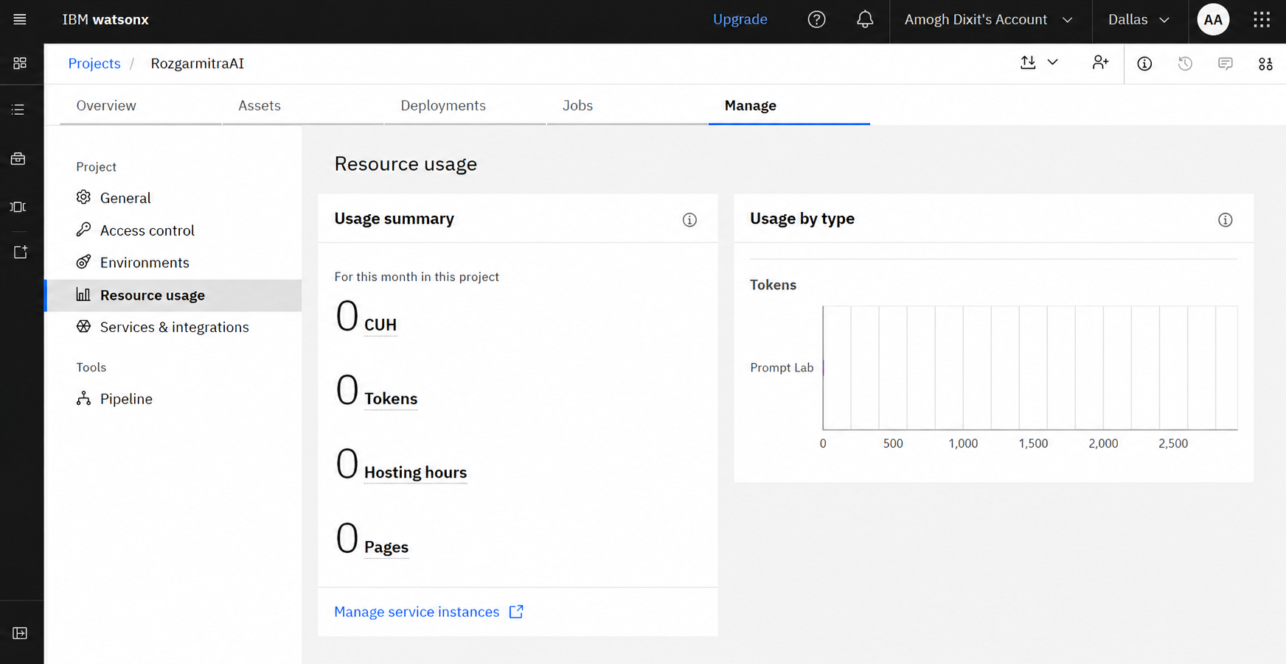
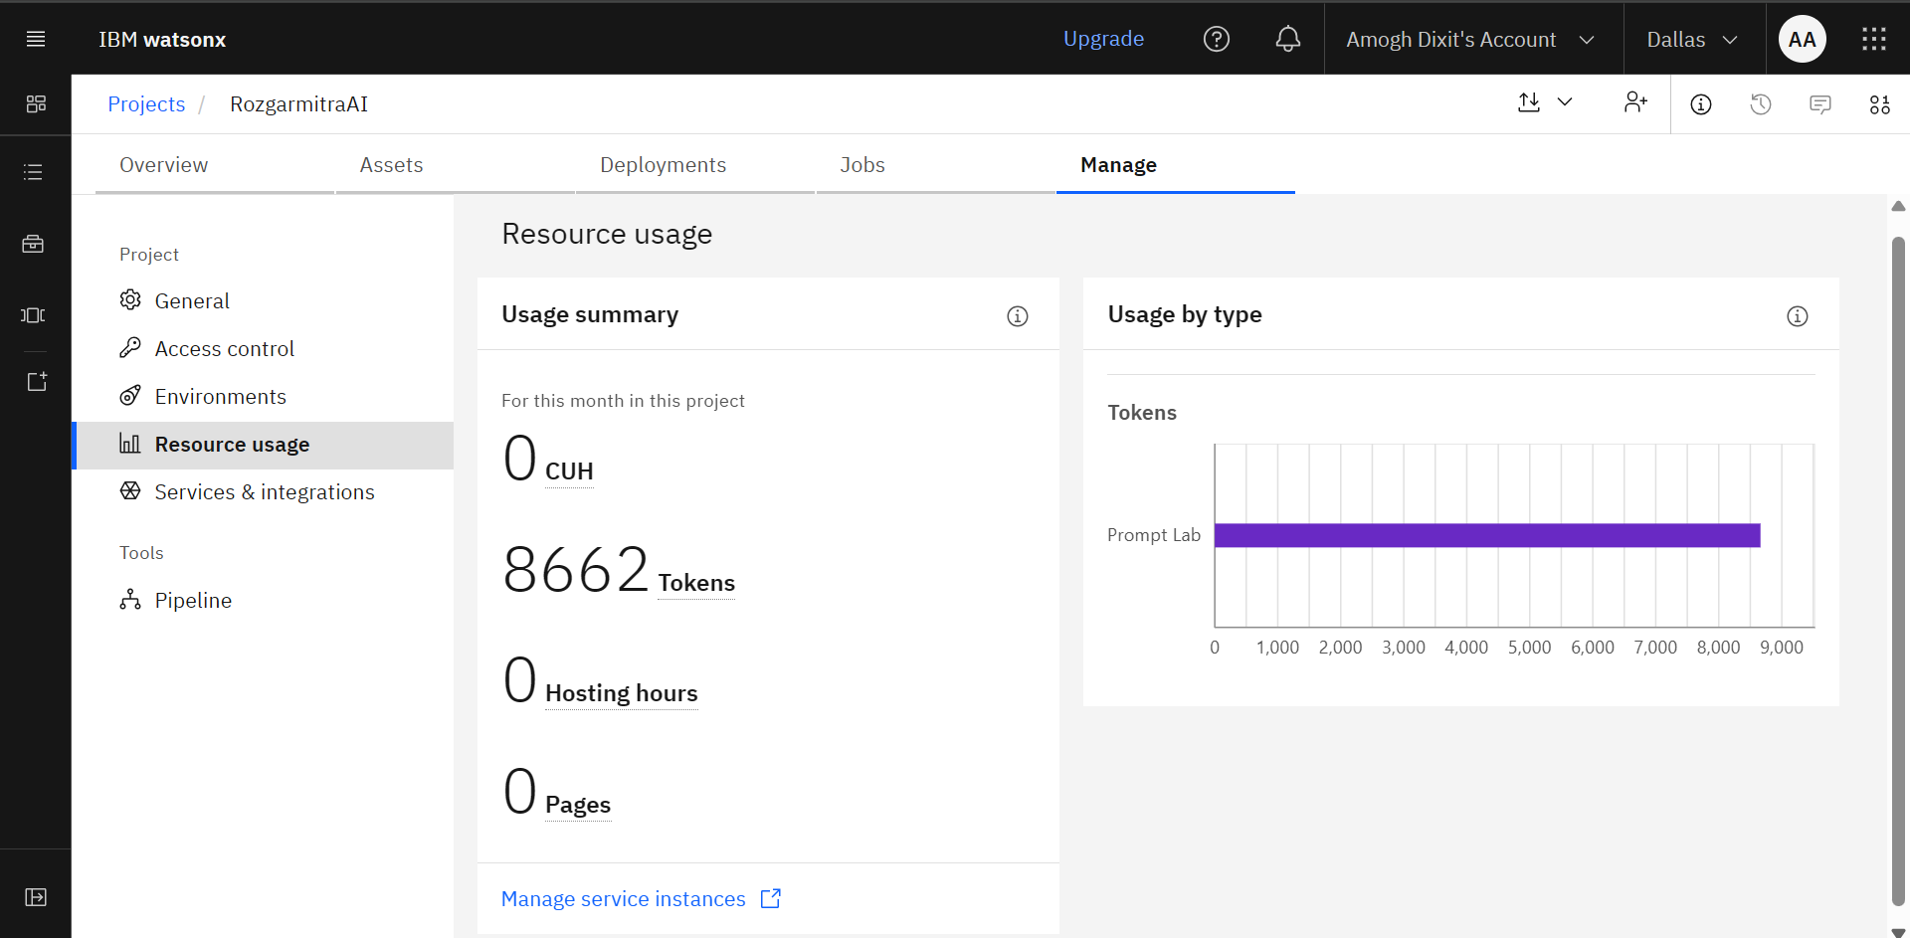
Token Usage & Efficiency -
IBM watsonx.ai – Token Usage & Optimization
▪ Resource Consumption: 8,662 tokens consumed through Prompt Lab; 0 CUH, hosting hours, and pages recorded. Foundation Model: IBM Granite for career guidance, resume analysis, interview preparation, and job matching.
Bounded Generation: Maximum output limited to 1,024 tokens to control response length and consumption.
Before Prompt
After Prompt

Slide 11
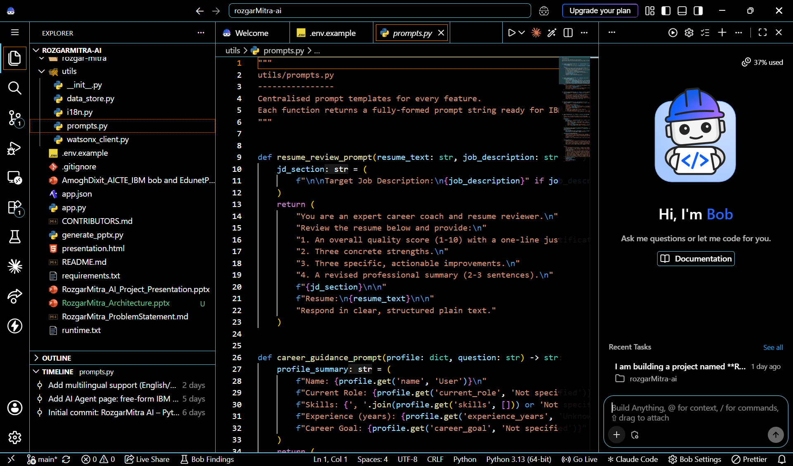
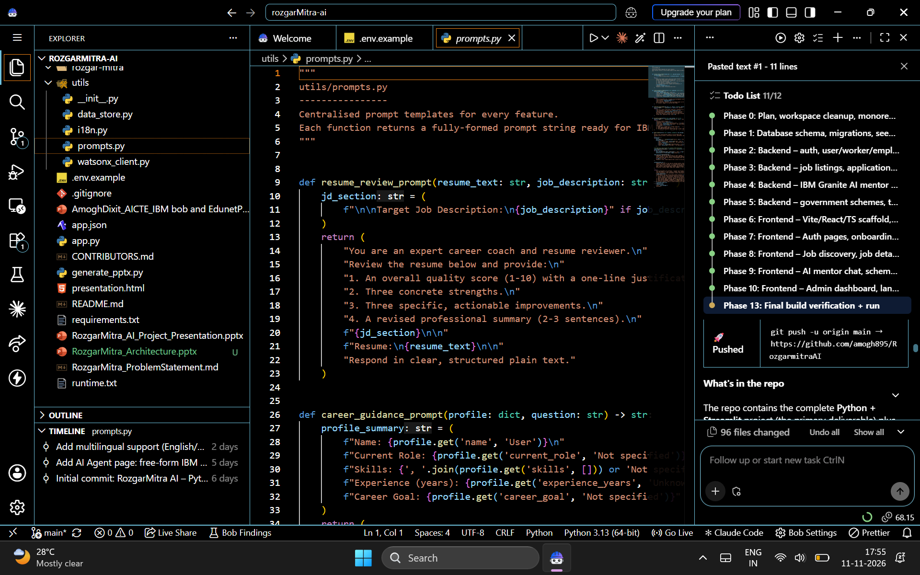
IBM Bob Usage Demonstration

Slide 12
Novelty and Uniqueness -
▪ Full-Lifecycle Career Mentorship: Unifies candidate profiling, resume auditing, role-specific STAR interview drills, semantic job matching, and conversational career guidance under one integrated platform – unlike fragmented single-purpose tools.
▪ Transparent & Calibrated ATS Scoring: Eliminates the opaque 'black box' of traditional ATS systems by providing numerical ratings (1–10) supported by 3 clear strengths, 3 actionable improvements, and a rewritten professional summary.
▪ Democratised & Zero-Cost Access: Designed without paid subscription barriers or heavy database infrastructure, expanding equitable access to high-quality career mentoring for early-career, vocational, and underserved job seekers.
▪ Deterministic Domain Guardrails: Built-in safeguards prevent off-domain drift and maintain an ethical, strictly professional mentoring environment – the agent politely declines non-career queries and redirects users to professional topics.
▪ Enterprise-Grade IBM Foundation: Powered by IBM Granite on watsonx.ai, guaranteeing reliable instruction following, factual alignment, and full enterprise AI governance and transparency standards.

Slide 13
GitHub Repository & Project Deliverables -
Public GitHub Repository URL:
https://github.com/amogh895/RozgarmitraAI
Deployment Details :
Platform: Streamlit Community Cloud (Free Tier)
Deployment URL: https://rozgarmitra-ai.streamlit.app

Slide 14
Future Scope -
▪ 1. Vernacular Multilingual Voice Assistant: Integrate IBM Watson Speech-to-Text and Text-to-Speech in regional Indian languages (Hindi, Tamil, Telugu, Marathi, Bengali) to empower semi-urban and rural job seekers with voice-guided career coaching.
▪ 2. Live Job Board & ATS API Integration: Connect directly with LinkedIn, Indeed, Naukri, and the National Career Service (NCS) API for real-time job scraping, one-click semantic matching, and automatic application tracking against live postings.
▪ 3. Multimodal Audio/Video Interview Coaching: Extend the Interview Coach to analyse candidate vocal modulation, pacing, filler word frequency, and facial confidence using multimodal AI evaluation during simulated interview drills.
▪ 4. Curated Upskilling & Certification Roadmaps: Automatically connect identified skill gaps to free, credentialed course modules on IBM SkillsBuild, Coursera, edX, and NPTEL, creating complete personalised learning roadmaps.

Slide 15
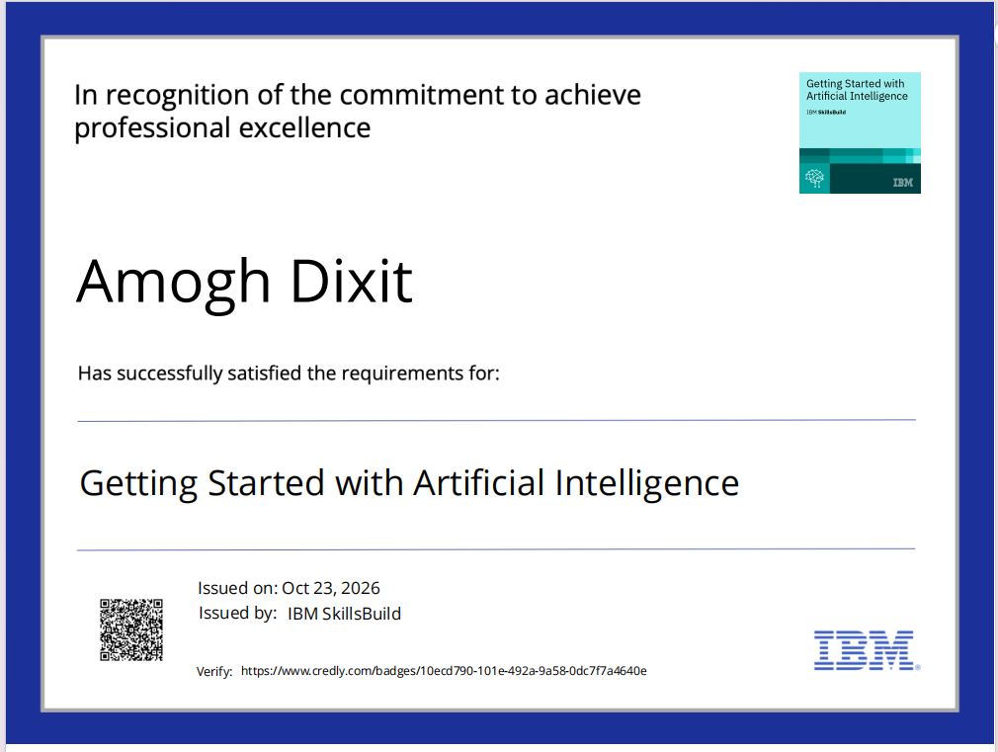
Certificates Earned:

Slide 16
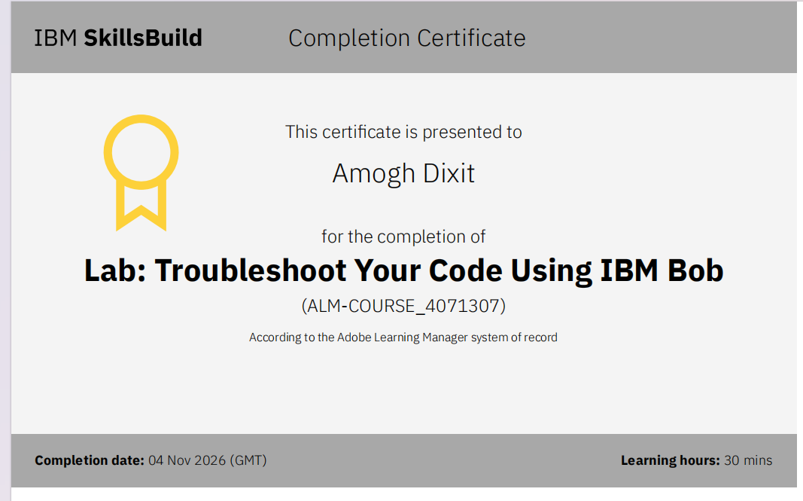
Certificates Earned:

Slide 17
Thank You!
Thank you for your time and interest.

